Slide 1



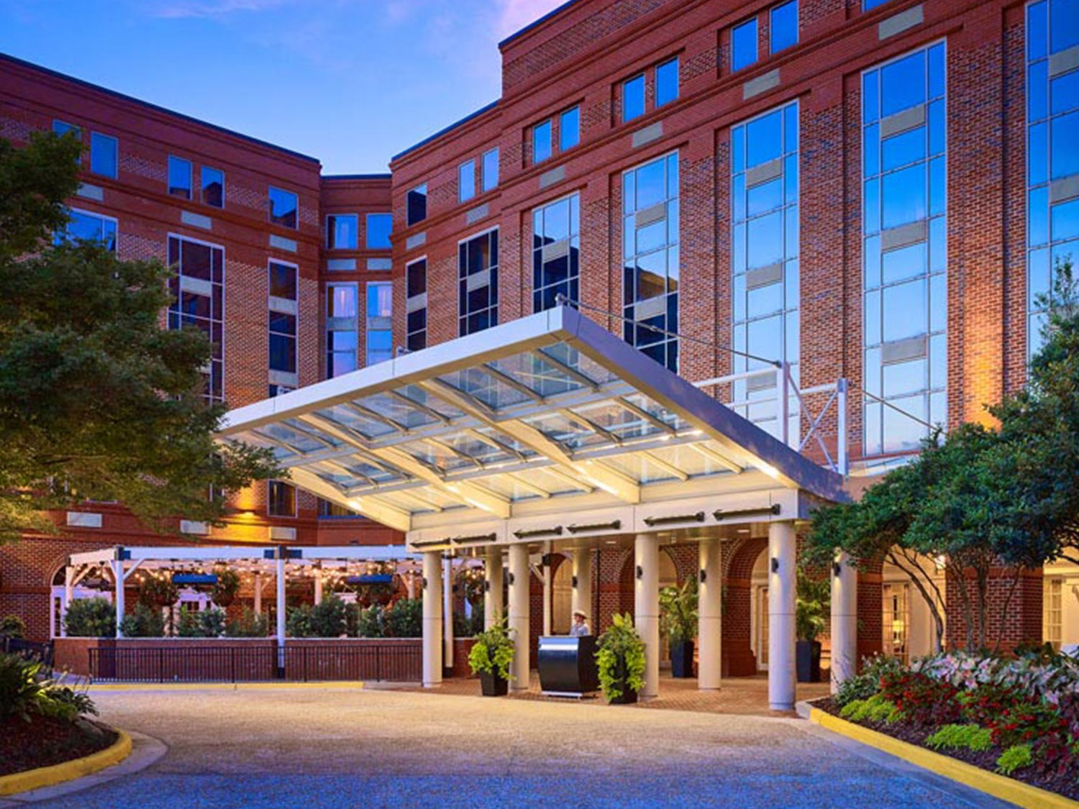
2026
Compass Conference
Navigating the Nursing Education Landscape
March 27-29, 2026
The Hotel at Auburn University and Dixon Conference Center
Presented by NCNAC

Slide 2


NCNAC Vision And Mission
Our Vision
NCNAC advances excellence in nursing academic student support, empowering educators and students to reach their academic and professional goals.
Our Mission
To foster nursing education excellence, we dedicate ourselves to empowering students through personalized coaching, innovative teaching methods, and evidence-based practices. By creating a collaborative environment, we create opportunities for students to thrive, embrace lifelong learning, and achieve their full potential. Together, we advance the field of nursing education by promoting research, sharing best practices, and advocating for continuous improvement.

Slide 3
2026 Conference Schedule
March 27-29, 2026
Tentative daily schedule
Friday, March 27, 2026
8:00 am – 12:00 pm | Registration: Boardroom
8:00 am – 12:00 pm | Exhibitor Set-up: Legacy Ballroom
12:00 pm – 2:00 pm | Lunch & Keynote Speaker: Grand Ballroom
2:00 pm – 2:50 pm | Workshop Session 1
3:00 pm – 3:50 pm | Workshop Session 2
4:00 pm – 4:50 pm | Workship Session 3
5:00 pm – 5:50 pm | Workshop Session 4
6:00 pm – 7:00 pm | Welcome Reception with Exhibitors & Poster Presentation: Pre-Function Foyer
Saturday, March 28, 2026
6:45 am – 7:15 am | Walking Groups: AUHCC Lobby
7:30 am – 8:45 am | Breakfast: Grand Ballroom
8:00 am – 9:00 am | Networking Round Tables: Grand Ballroom
9:00 am – 9:50 am | Workshop Session 5
10:00 am – 10:50 am | Workshop Session 6
11:00 am – 11: 50 am | Workshop Session 7
12:00 pm – 1:30 pm | Lunch Break – Lunch on your own: Grand Ballroom VENDORS
1:30 pm – 2:20 pm | Workshop Session 8
2:30 pm – 3:20 pm | Workshop Session 9
3:20 pm – 3:45 pm | Break with Exhibitors: Legacy Ballroom
3:45 pm- 4:35 pm | Workshop Session 10
4:35 pm | TBD
Sunday, March 29, 2026
6:45 am – 7:15 am | Walking Groups: AUHCC Lobby
7:30 am – 8:45 am | Breakfast: Grand Ballroom Networking Round Tables: Grand Ballroom
9:00 am – 9:50 am | Workshop Session 11
10:00 am – 10:50 am | Workshop Session 12
10:50 am – 11:15 am | Break with Exhibitors: Legacy Ballroom
11:15 am – 12:05 pm | Workshop Session 13
12:15 pm – 14:00 pm | TBD

Slide 4
Areas of Focus
Emphasis on current practice presentations!
E
W
N
S
Empowering Nursing Students Dealing with Anxiety
Wellness and Resilience: Winning Approaches for Nursing Student Well-Being
Navigating Time Management Challenges
Studying for Success
Areas of Interest:
Holistic Wellness Approaches
Resilience Building Strategies
Support Programs
Integrative Practices
Curriculum Integration
Technology and Wellness
Areas of Interest:
Identifying Challenges
Effective Techniques
Technology Solutions
Personalization
Support Systems
Areas of Interest:
Effective Study Techniques
Time Management
Test Preparation
Technology Integration
Customized Learning Plans
Areas of Interest:
Intervention Programs
Support Systems
Skill Development
Curriculum Integration
Technology and Resources
Student Perspectives

Slide 5





Submissions
Due December 1, 2025
Poster
Podium
Offered in-person at the conference venue.
Posters will be displayed, one poster per board.
All posters should be in landscape format and should be 3’10’’ by 3’10” with a font size 20 or more
Offered as in-person presentations at the conference venue.
Podium presentations are allotted for 40 minutes, with 5 minutes for questions.

Slide 6
Vendor & Sponsorship Information
Vendor
Sponsorship
Exhibitor Fee $1000
Includes: Table, 2 chairs, 2 registrations for staff members
Additional staff: $300/person
Spaces will be assigned after the December 1, 2025 deadline
LAST opportunity for vendors to register: January 15, 2026
Platinum Level $5, 500
  Includes Lunch/Reception sponsorship opportunities
Gold Level $5,000
  Breakfast sponsorship
Silver Level $4,000
  Refreshment break sponsor
  Plenary speaker sponsor
Bronze Level $2500
  Attendee Lanyards
All interested vendors or sponsors please refer to
Beth Hultquist 704-785-0393

Slide 7
Important Dates
December 1, 2025
  Poster & Presentation Submissions Due
February 2, 2026
  Last day to register as early bird rate: $400
  Undergraduate Student rate: $175
February 16, 2026
  Last day to register at regular rate: $500
March 16, 2026
  Last day to register at late rate: $600
  QUESTIONS? Beth_Hultquist@baylor.edu

Slide 8
Important Links
Presentation/Poster Submissions
  https://auburn.qualtrics.com/jfe/form/SV_2boPIS1xFf8yLXM
Conference registration link
  2026 NCNAC Compass Conference | Auburn University
Hotel Link
  The Hotel at Auburn University and Dixon Conference Center - Reservations - Room Availability
  QUESTIONS? Beth_Hultquist@baylor.edu

Slide 9
Important Links
Vendor/Sponsor Registration
  2026 NCNAC Compass Conference - Vendors & Sponsors | Auburn University
  QUESTIONS? Beth_Hultquist@baylor.edu

